Slide 1
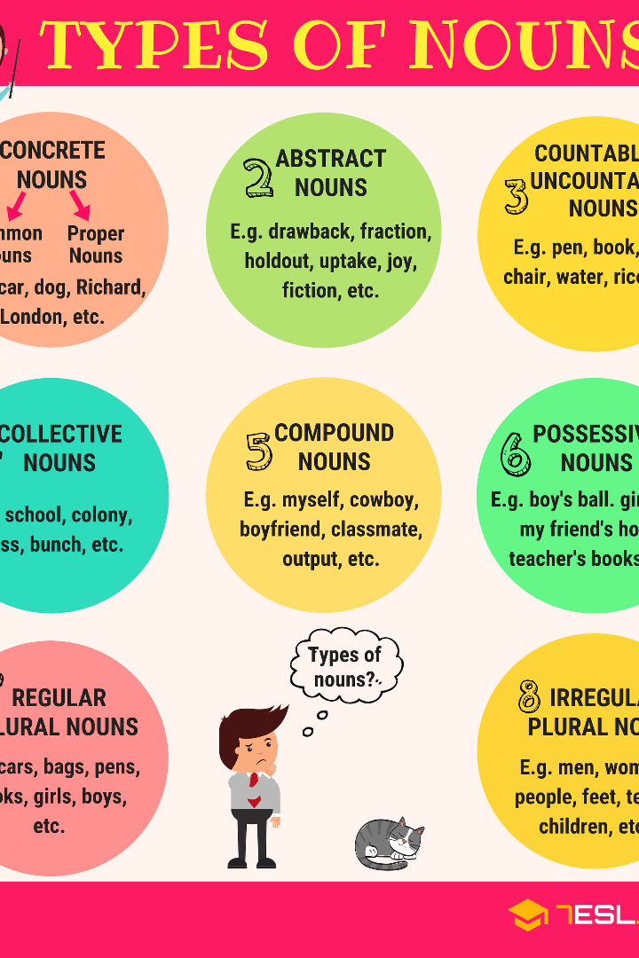

Noun and its types
Explore the fascinating world of nouns and discover their different types. From common nouns to abstract nouns, learn how words can bring ideas to life.
by Faseh Tariq

Slide 2
Common Nouns
Definition
Examples
Usage
Common nouns are names for general things or people.
chair, city, cat
Common nouns are used in everyday conversations and writing.

Slide 3

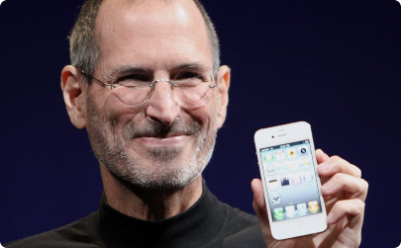
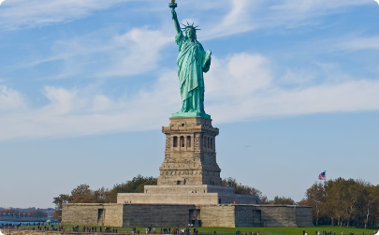
Proper Nouns
Definition
Examples
Usage
Proper nouns are specific names of people, places, or things.
Eiffel Tower, Steve Jobs
Proper nouns are capitalized and used to refer to unique entities.

Slide 4

Abstract Nouns
1
Definition
2
Examples
Abstract nouns represent ideas, emotions, or qualities.
love, happiness, courage
3
Usage
Abstract nouns are intangible and often expressed through feelings.

Slide 5
Concrete Nouns
1
Definition
Concrete nouns refer to objects that can be perceived by the senses.
2
Examples
tree, car, apple
3
Usage
Concrete nouns provide tangible descriptions in writing and speech.

Slide 6


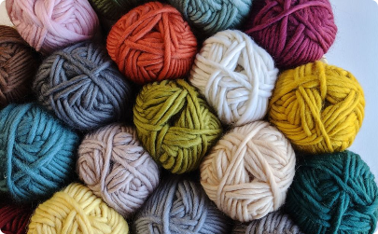
Material Nouns
Definition
Examples
Usage
Material nouns identify substances that things are made of.
gold, brick
Material nouns are often used in manufacturing or crafting contexts.

Slide 7
Collective Nouns
Definition
Examples
Usage
Collective nouns represent groups of people or things.
team, flock, herd
Collective nouns describe a collection of individuals as a single entity.

Slide 8
Compound Nouns
1
Definition
Compound nouns are formed by combining multiple words.
Examples
2
hairbrush, basketball, blackboard
3
Usage
Compound nouns clarify specific objects or concepts.

Slide 9
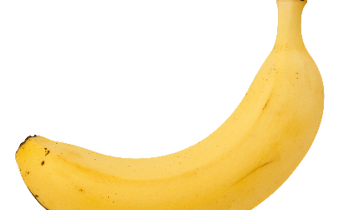
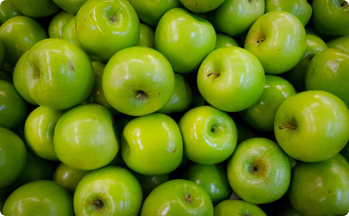

Countable Nouns
Definition
Examples
Usage
Countable nouns can be quantified and have both singular and plural forms.
banana, apple
Countable nouns allow for measurement and comparison.

Slide 10

Uncountable Nouns
1
Definition
2
Examples
3
Usage
Uncountable nouns cannot be counted or have a plural form.
water, sugar, happiness
Uncountable nouns describe things that are seen as a whole or abstract concepts.

